Slide 1
Design of Members - shear
❑ 구성
G1. General Provisions
G2. I-Shaped Members and Channels
G3. Single Angles and Tees
G4. Rectangular HSS, Box Sections, and other Singly and Doubly Symmetric Members
G5. Round HSS
G6. Weak-Axis Shear in Doubly Symmetric and Singly Symmetric Shapes
G7. Beams and Girders with Web Openings

Slide 2
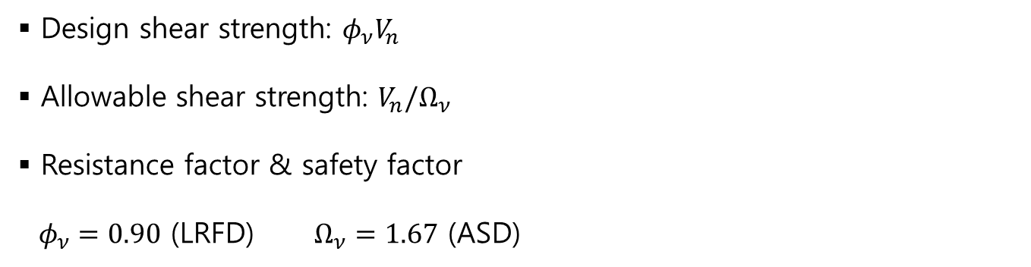
Design of Members - shear
❑ General Provisions
▪ Design shear strength: $φ_{ν}V_{n}$
▪ Allowable shear strength: $V_{n}/Ω_{ν}$
▪ Resistance factor & safety factor $φ_{ν}=0.90$ (LRFD) $Ω_{ν}=1.67$ (ASD)

Slide 3
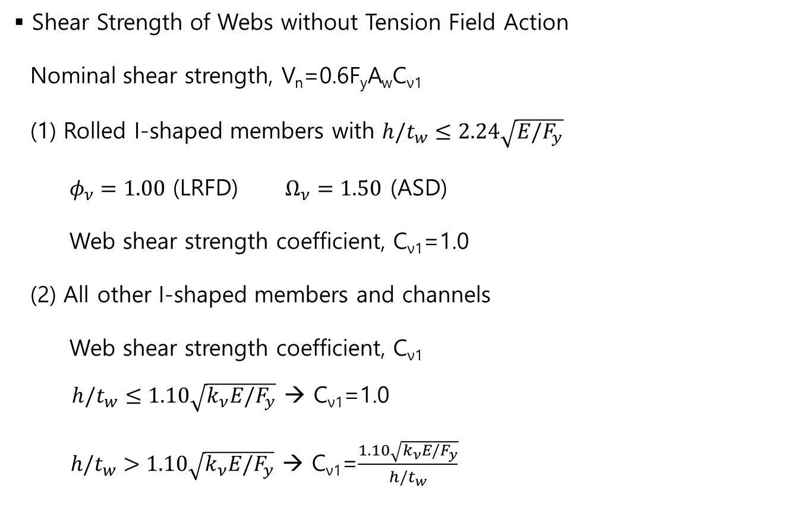
Design of Members - shear
❑ I-Shaped Members and Channels
▪ Shear Strength of Webs without Tension Field Action Nominal shear strength, V_{n}=0.6F_{y}A_{w}C_{ν1}
(1) Rolled I-shaped members with $h/t_{w}≤2.24\sqrt{E/F_{y}}$
$φ_{ν}=1.00$ (LRFD) $Ω_{ν}=1.50$ (ASD)
Web shear strength coefficient, C_{ν1}=1.0 (2) All other I-shaped members and channels Web shear strength coefficient, C_{ν1} $h/t_{w}≤1.10\sqrt{k_{ν}E/F_{y}}$ → C_{ν1}=1.0
$h/t_{w}>1.10\sqrt{k_{ν}E/F_{y}}$ → C_{ν1}=$\frac{1.10\sqrt{k_{ν}E{/F}_{y}}}{h/t_{w}}$
→ Shear Yielding
→ Inelastic shear buckling
→ Elastic shear buckling

Slide 4
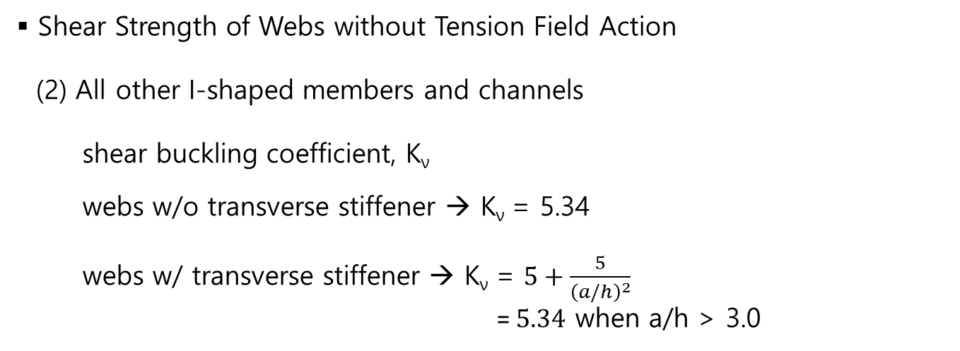
Design of Members - shear
❑ I-Shaped Members and Channels
▪ Shear Strength of Webs without Tension Field Action (2) All other I-shaped members and channels shear buckling coefficient, K_{ν} webs w/o transverse stiffener → K_{ν} = 5.34
webs w/ transverse stiffener → K_{ν} = $5+\frac{5}{{\left(a/h\right)}^{2}}$
= $5.34$ when a/h > 3.0
a=distance between transverse stiffeners
h=distance between flanges

